Slide 1
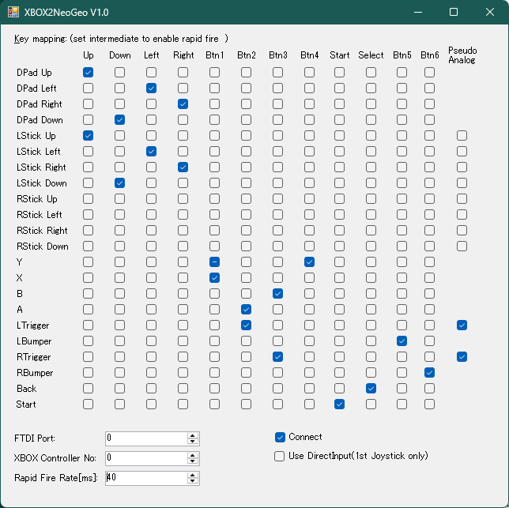
This settings enabled “Pseudo Analog”.
It means… - When you press the trigger slightly, the satellite moves slowly.
- When you press the trigger fully, the satellite moves at full speed.

